Slide 1






Data Heroines
Saving the world through data
Vol. 01

Slide 2



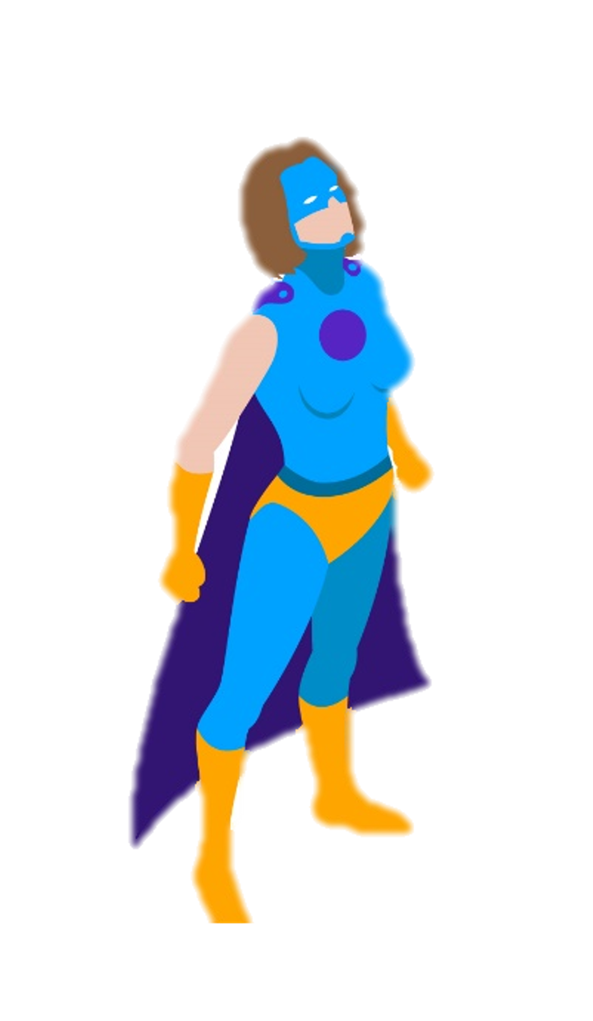
Meet the heroines
Datana Scientistus
Machina Learnerum
Datana Analystus
Datana Enginerus

Slide 3




What would be great questions to answer here? We gotta start somewhere…
Hi, DS, I can help you start this adventure. I have here a list of questions to help you explore this great big sea of data.

Slide 4

Did the number of women answering the survey increase, decrease or stay about the same?
Did we have a significant change in the distribution of women per country in the dataset?
What about salaries, anything we should look out for?
What job titles do women hold? And education level?
Do women tend to work in big or small companies?
What are we going to find out about learning plataforms?
And about the most used and the most recommended languages? I've heard rumors about some kind of Python's supremacy.

Slide 5


Datana Analystus helped me a lot! Now I will meet Machina Learnerum first and then Datana Enginerus and hope they will help me too.

Slide 6



Of course DS, what do you need?
Hello Machina Learnerum could you help me?

Slide 7

We'll get only the five most frequent countries that appears in the survey in 2021!

Slide 8



These values are aggregated values, right?
Yes!

Slide 9
So I guess these values are also aggregated values, right?
Yes!

Slide 10

These are NOT aggregated values!

Slide 11

Thanks for reading!
To be continued…
See you soon

Slide 12
Thanks for reading!
To be continued…
See you soon

Slide 13
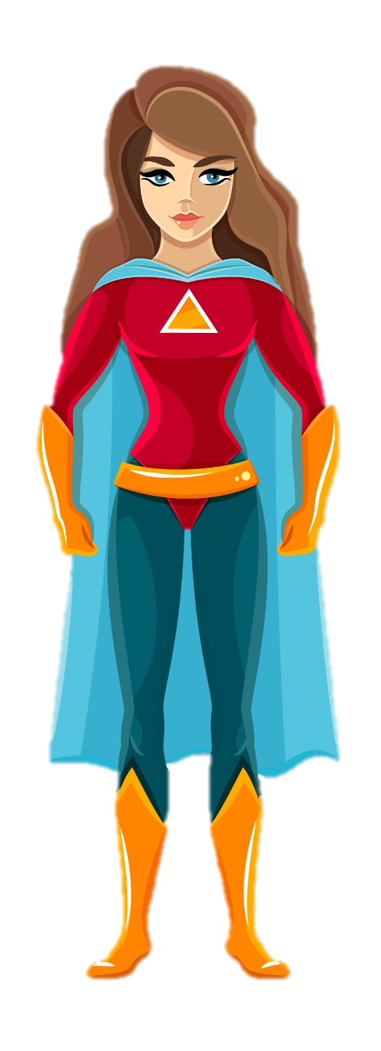




Slide 14


Slide 15


